Slide 1
End of Semester Presentation
YALA! Ptolemy
Yousef Alsaeed
Ashwini Bijwe
Lyle Holsinger
Alek Wang

Slide 2
Agenda
Project Overview
Project Demo
Risks & Goals
Summer Proposals Evaluation
Quality
Client Feedback
Fall Plan

Slide 3

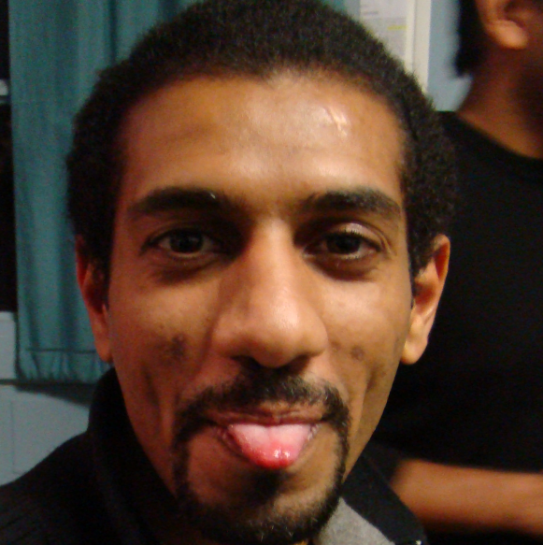

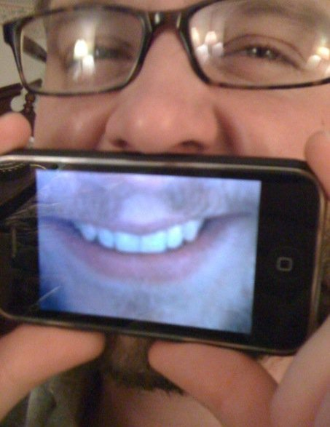
Team YALA!
About
Demo
Goals & Risks
Operations
Planning
Development
Quality
Feedback
Fall
Alek
Yousef
Ashwini
Lyle

Slide 4
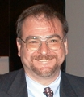
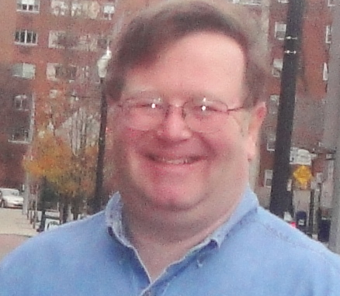

Team YALA!
About
Demo
Goals & Risks
Operations
Planning
Development
Quality
Feedback
Fall
Cliff
Eduardo
Shigeru

Slide 5
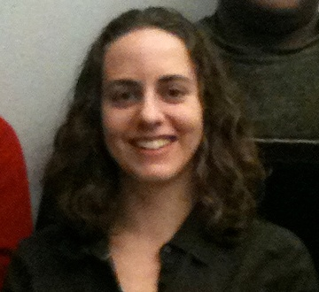
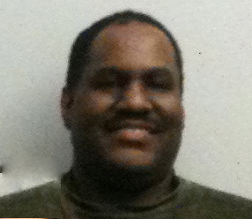
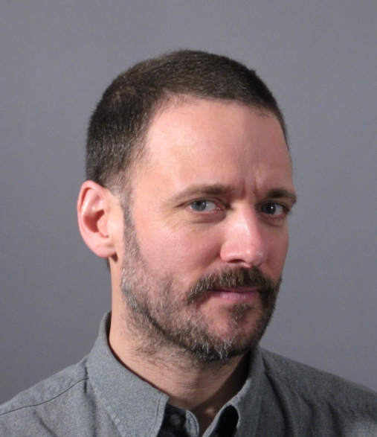
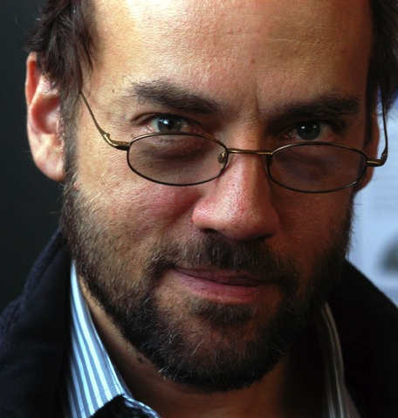
Team YALA!
About
Demo
Goals & Risks
Operations
Planning
Development
Quality
Feedback
Fall
Bosch RTC
UC Berkeley

Slide 6



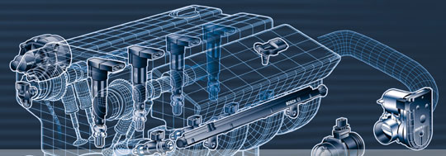
Robert Bosch GmbH
About
Demo
Goals & Risks
Operations
Planning
Development
Quality
Feedback
Fall

Slide 7
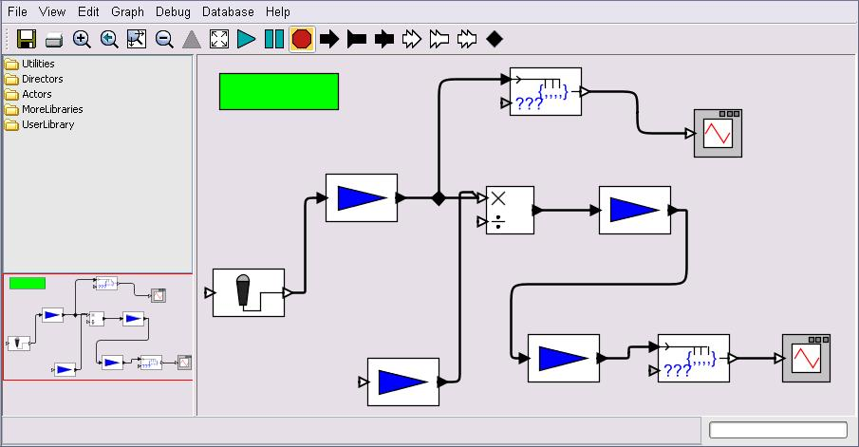

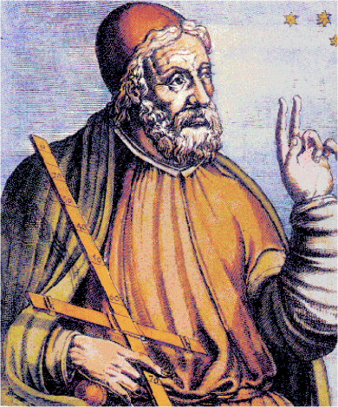

Ptolemy – Open Source Modeling Tool
About
Demo
Goals & Risks
Operations
Planning
Development
Quality
Feedback
Fall
An Open Source
Project at

Slide 8
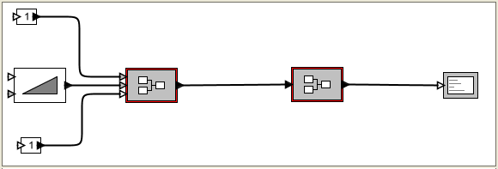
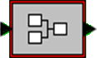
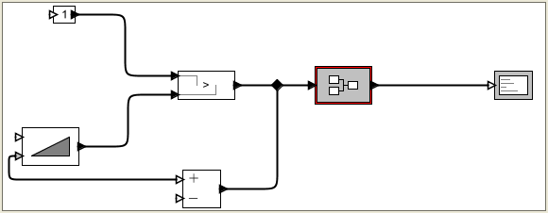
Re-use of model
About
Demo
Goals & Risks
Operations
Planning
Development
Quality
Feedback
Fall
Model A
Model A
Model B
SimpleAdder
Model C
Model B
Model D

Slide 9

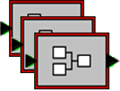


Project Vision
About
Demo
Goals & Risks
Operations
Planning
Development
Quality
Feedback
Fall
Save
XML Database
Ptolemy User 1
Search
Ptolemy User 2
Load

Slide 10

Product Demo

Slide 11
Major PtolemyDB Features List
Referencing
Multi-level referencing
Searching
Simple attribute search
Advanced graphical pattern matching search
Circular dependency checks

Slide 18
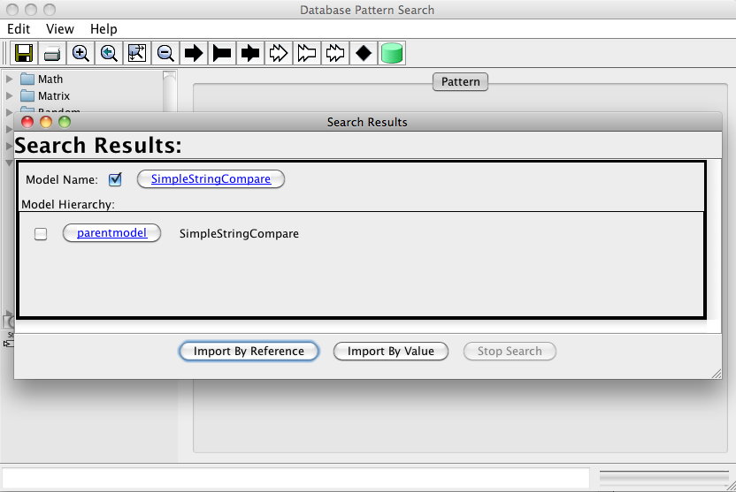

Slide 19
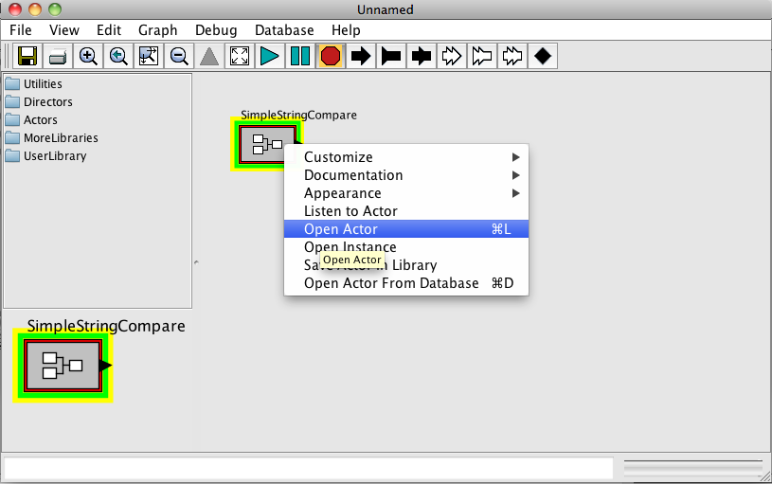

Slide 21

Goals

Slide 22



Achievements
About
Demo
Goals & Risks
Operations
Planning
Development
Quality
Feedback
Fall
Client Goals | Status
Deliver code and unit TCs for Level 0 and Level 1 as listed in the Priority Requirement Document by end of July 2010
Create a test plan by end of May 2010
Test and pass quality attribute measures by end of July 2010
JUnit TCs will cover 85% line coverage and 75% branch coverage and the code passes these TCs
Partially
achieved
Not
achieved
Achieved

Slide 23
Achievements
About
Demo
Goals & Risks
Operations
Planning
Development
Quality
Feedback
Fall
Team Goals | Status
At the end of the July 2010, our code will pass the nightly build with regards to the Coding Style, Java Documentation Guidelines and Findbugs
Have fun every week. Go to Kennywood. Organize an after-release party. Track using team morale tracking
Participate in at least one code review with UC Berkeley prior to the first release
Communicate with the clients every week through client meetings and emails
Never break the open source build
Improve estimation by each iteration
Partially
achieved
Not
achieved
Achieved

Slide 24

Risks

Slide 25
Top Risks
About
Demo
Goals & Risks
Operations
Planning
Development
Quality
Feedback
Fall
Description | Mitigation
Inadequate performance due to XML Database | Use tactics (e.g. caching) Measure the performance
Task delays due to large number of tasks and their dependencies | Stand-up meetings & Common working time Use matrix to identify dependencies
Burn out which can affect team productivity | Weekly team building activities Weekly team morale tracking

Slide 26

TEAM SPirit
Operations

Slide 27

Team Meetings
About
Demo
Goals & Risks
Operations
Planning
Development
Quality
Feedback
Fall
Standup Meetings
Track daily status
Status Meetings
TSP script did not work for our team
Meetings were low energy
Did not sufficiently show our progress

Slide 28

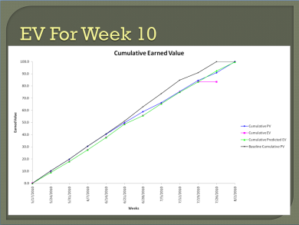
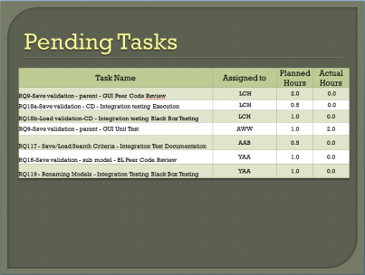
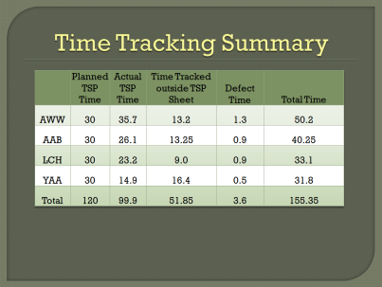
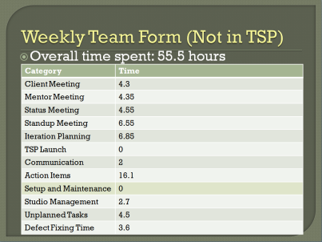


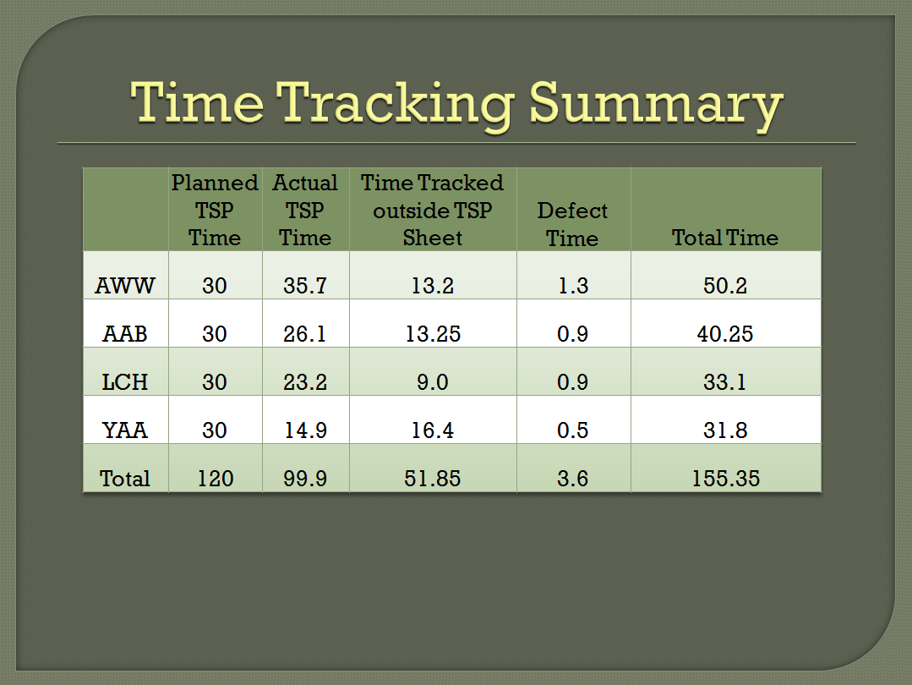
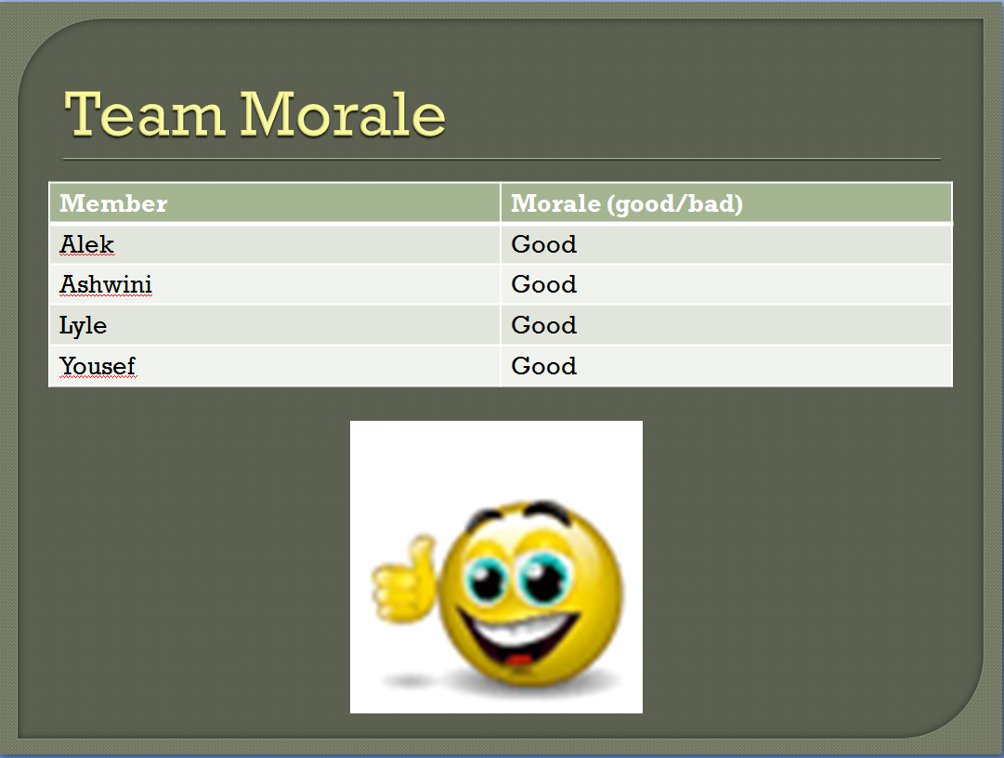
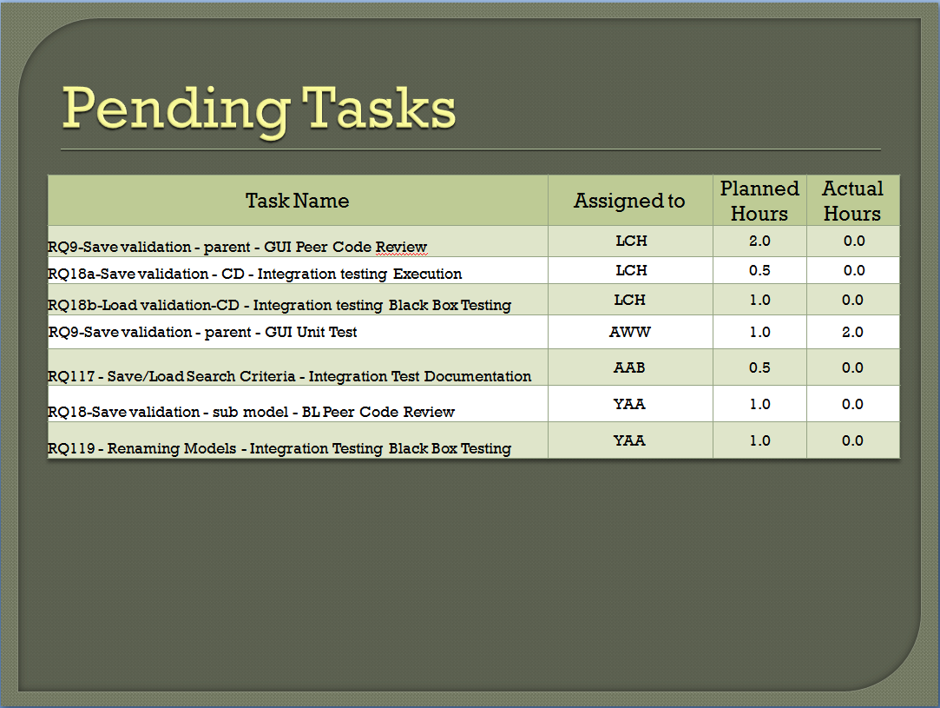
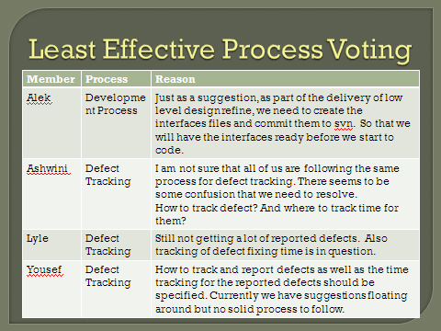
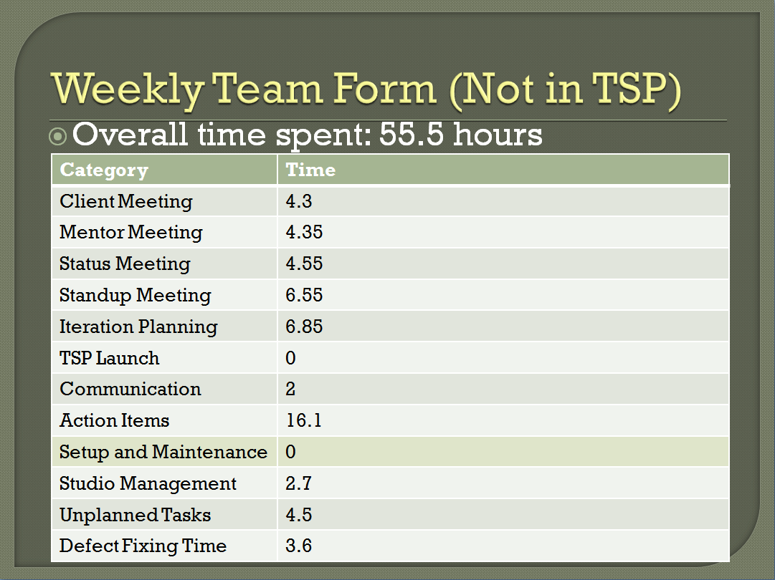
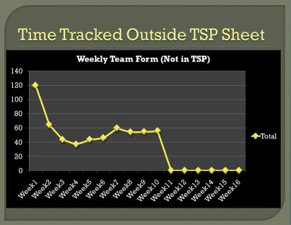
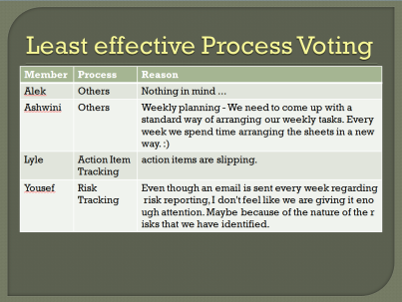

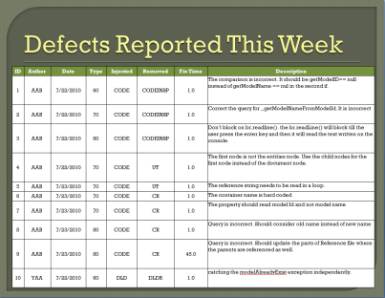
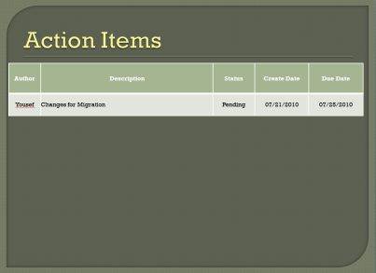
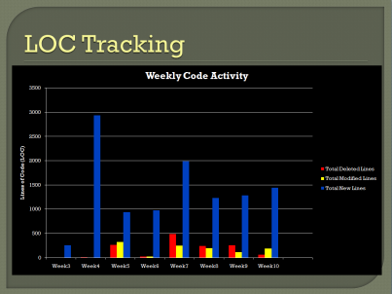
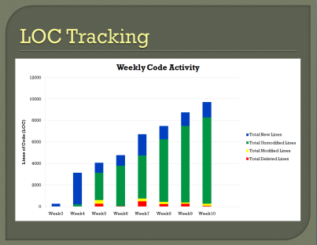
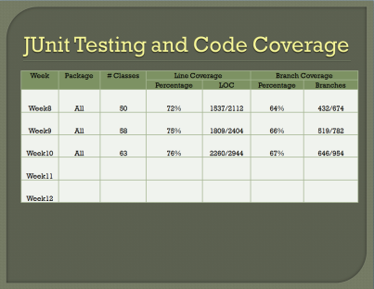
Status Meeting
About
Demo
Goals & Risks
Operations
Planning
Development
Quality
Feedback
Fall
R
E
F
L
E
C
T
I
O
N
S
We are glad that we…
Continuously improved our processes using feedback in weekly status meetings
It prevented problems from getting out of control
Created a structured format for our status meetings that utilized visual aids

Slide 29
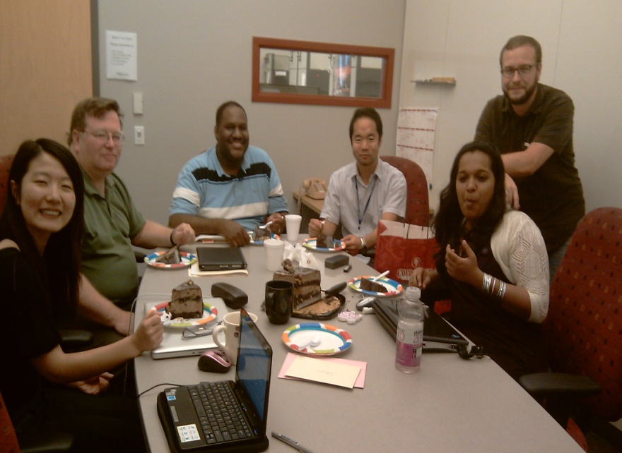
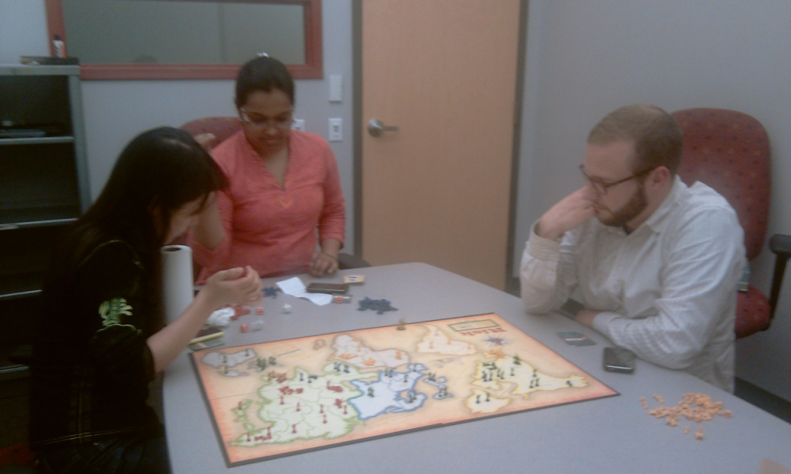

Team Morale & Activities
About
Demo
Goals & Risks
Operations
Planning
Development
Quality
Feedback
Fall
Ashwini’s foot
Birthdays
Games
Adventure

Slide 30

Planning &
Tracking

Slide 31
Earned Value Chart
About
Demo
Goals & Risks
Operations
Planning
Development
Quality
Feedback
Fall
R
E
F
L
E
C
T
I
O
N
S
We are glad that we…
Total Planned Hours: 1289
Total Actual Hours: 1114
Made small, incremental changes to our plan instead of major, drastic changes
We benefited from improvements in the plan without overcompensating
Week 6
Number of On Task Hours Reduced From 36 hours to 30 Hours

Slide 32
Distribution of Time
Start Semester Rush
End Semester Rush
About
Demo
Goals & Risks
Operations
Planning
Development
Quality
Feedback
Fall
Mid Semester Slump
EOSP preparation
Environment setup activities only at the beginning of summer
TSP Launch
TSP Reflection
Iteration meetings
TSP Launch
Studio Activities
Environment Setup

Slide 33
Release Activities
About
Demo
Goals & Risks
Operations
Planning
Development
Quality
Feedback
Fall
Planned Hours –1159
Actual Hours – 927

Slide 34
Productivity Analysis
About
Demo
Goals & Risks
Operations
Planning
Development
Quality
Feedback
Fall
R
E
F
L
E
C
T
I
O
N
S
Boy, we wish that we…
 | LOC Added | Planned Hours | Actual Hours | Estimation Error | Productivity (LOC/Hour) | Unique Req’t Met
Release 1 | 5524 | 491.9 | 397.6 | 23.7% | 13.9 | 6
Release 2 | 6439 | 363.3 | 281.8 | 28.9% | 22.8 | 11
Release 3 | 5124 | 303.7 | 248.1 | 22.2% | 20.6 | 14
Total | 17,087 | 1,158.9 | 927.5 |  |  | 31
Had considered our increase in efficiency in our estimations
Although we adjusted our plan to account for our previous overestimation, our increase in efficiency canceled out these adjustments.

Slide 35
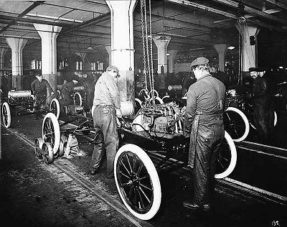
Development

Slide 36
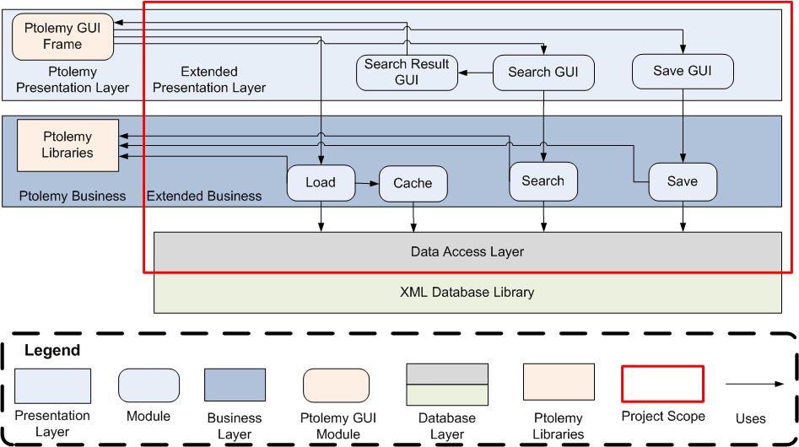
High-level Static View
About
Demo
Goals & Risks
Operations
Planning
Development
Quality
Feedback
Fall
Notes:
Layered architecture
Coming up with process

Slide 37
Development Process
About
Demo
Goals & Risks
Operations
Planning
Development
Quality
Feedback
Fall
GUI Layer
Detailed Design
Design Review
Code
Code Review
JUnit Test
Peer Code Review
Business Layer
Detailed Design
Design Review
Code
Code Review
JUnit Test
Peer Code Review
Database Layer
Detailed Design
Design Review
Code
Code Review
JUnit Test
Peer Code Review

Slide 38
Development Process
About
Demo
Goals & Risks
Operations
Planning
Development
Quality
Feedback
Fall
R
E
F
L
E
C
T
I
O
N
S
Requirement 1
We are glad that we…
Layer Interface Design & Review
Detailed Design & Development
Layer Integration Testing
Followed breadth-wise development
Produced complete product with each release
Received instant feedback
System Testing
Demo
Requirement 2
Layer Interface Design & Review
Detailed Design & Development
Layer Integration Testing

Slide 39
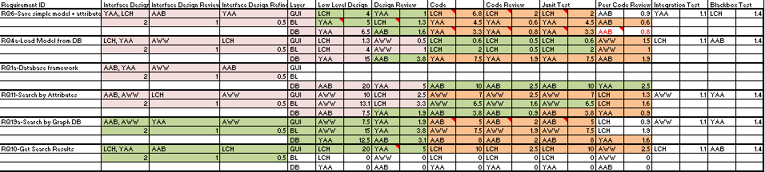
Tracking Using the Matrix**
About
Demo
Goals & Risks
Operations
Planning
Development
Quality
Feedback
Fall
What is the matrix?
Requirements vs. Phases
Benefits
Who depends on you?
Who do you depend on?
Order of tasks
Day-today status
Plan for iterations
** As proposed by VdashNeg (MSE ‘09 Team)

Slide 40
Open Source Development
About
Demo
Goals & Risks
Operations
Planning
Development
Quality
Feedback
Fall
Nightly builds to enforce
Code style
Javadocs
FindBugs
JUnit tests
Transparency of work
2 Fagan Inspections with UC Berkeley

Slide 41
Time Spent in Development Activities
About
Demo
Goals & Risks
Operations
Planning
Development
Quality
Feedback
Fall

Slide 42
Test Coverage
About
Demo
Goals & Risks
Operations
Planning
Development
Quality
Feedback
Fall
Goal - 85% Line Coverage & 75% Branch Coverage
Week | # Classes | Line Coverage |  | Branch Coverage
 |  | Percentage | LOC | Percentage | Branches
Week 8 | 50 | 72% | 1537/2112 | 64% | 432/674
Week 9 | 58 | 75% | 1809/2404 | 66% | 519/782
Week 10 | 63 | 76% | 2260/2944 | 67% | 646/954
Week 11 | 63 | 75% | 2271/2991 | 67% | 666/992

Slide 43
Development Results
About
Demo
Goals & Risks
Operations
Planning
Development
Quality
Feedback
Fall
Total Physical LOC – 17K
Total Logical LOC - 10.5K
Chart created using Unified Code Counter (A tool developed at University of Southern California)
Notes:
Grows at a constant rate

Slide 44
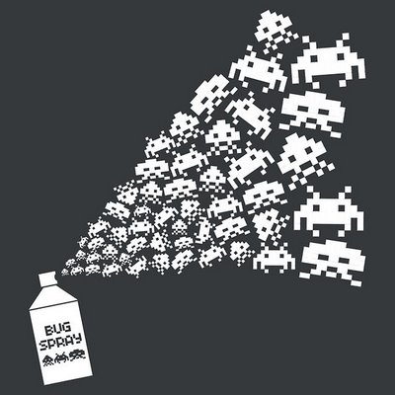
Quality
Defect Analysis

Slide 45







Defects
66 hours
7% of
development
effort
237 defects found
3 still open

Slide 46
Average defect fix time
Average Fix Times
- 17 minutes per defect
- 10 minutes per defect found in reviews
80-20 Rule
- 80% of the defect were fixed in 31% of the total fix time

Slide 47
Average defect fix time
As the distance between the phase where defect was injected and phase where it was removed increased, the time taken to fix it increased.

Slide 48
Defects Found in Reviews & Inspections
R
E
F
L
E
C
T
I
O
N
S
Boy, we wish that we…
Spent more time in reviews, especially code reviews
Data shows that the average time to fix a defect found in reviews is less than defects found in other places
72% of the defects were introduced in code

Slide 49
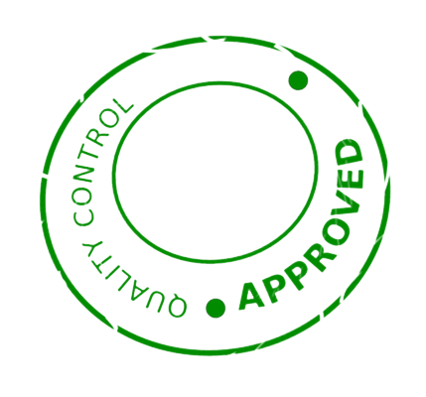
PtolemyDB
Quality
Performance

Slide 50
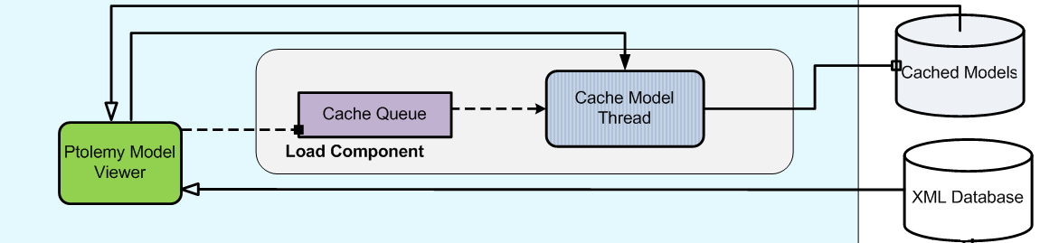
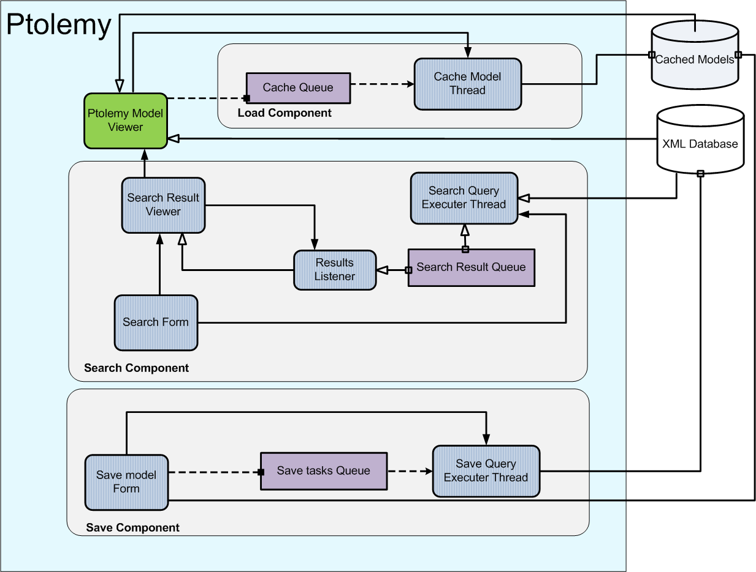
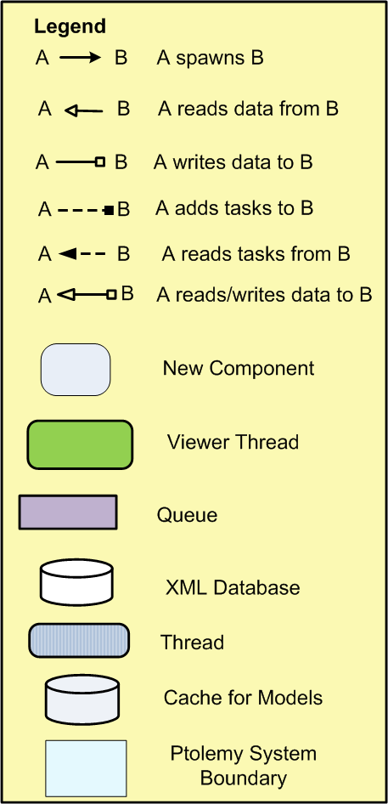
Dynamic View
About
Demo
Goals & Risks
Operations
Planning
Development
Quality
Feedback
Fall
50

Slide 51
Performance Data
About
Demo
Goals & Risks
Operations
Planning
Development
Quality
Feedback
Fall

Slide 52

the road ahead…
Client Feedback

Slide 53
Clients’ Feedback
About
Demo
Goals & Risks
Operations
Planning
Development
Quality
Feedback
Fall
We are happy with what you have done so far. Excellent work!
Elizabeth Latronico
Charles Shelton

Slide 54
UC Berkeley team’s feedback
About
Demo
Goals & Risks
Operations
Planning
Development
Quality
Feedback
Fall
We congratulate you on your achievement. We look forward to using it.
Prof. Edward Lee
Christopher Brooks

Slide 55

the road ahead…
Fall Semester

Slide 56
Plan for Fall 2010
About
Demo
Goals & Risks
Operations
Planning
Development
Quality
Feedback
Fall

Slide 57
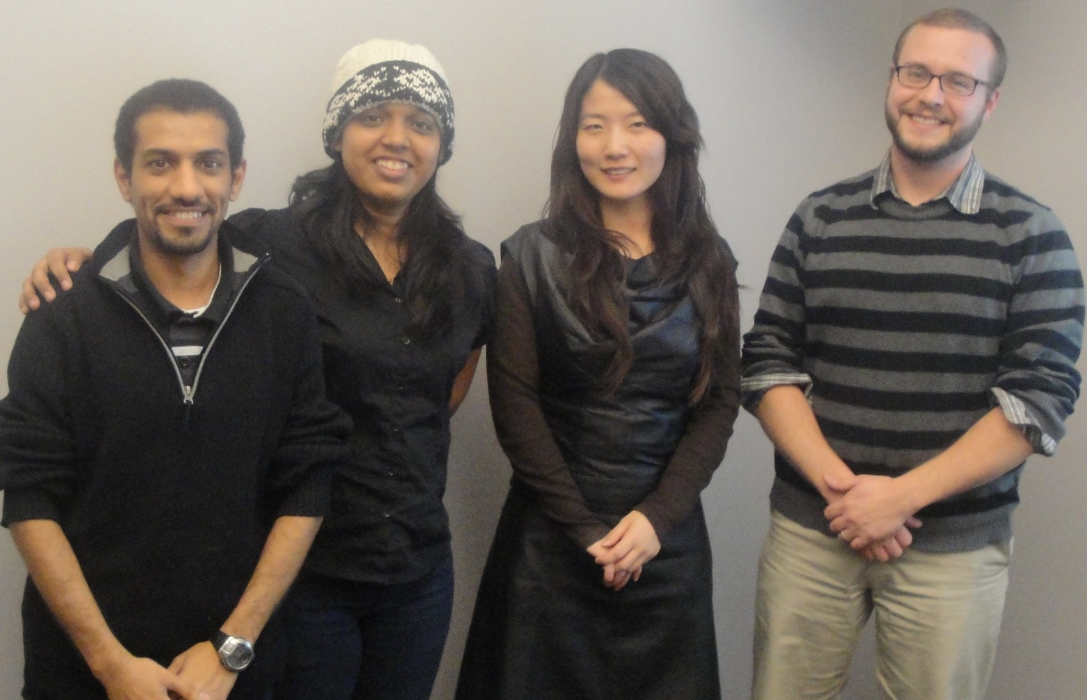
Roles for Fall
About
Demo
Goals & Risks
Operations
Planning
Development
Quality
Feedback
Fall
Process
&
Support
Development
Team Lead
Planning

Slide 58

Questions

Slide 59
Questions

Slide 60
Questions

Slide 61
Questions

Slide 62
BACKUP SLIDES

Slide 63
Releases and Client Demos
Three Releases, with each release
Demo of the features introduced in the release
Release Notes
System test scenarios and their results
Running system & code

Slide 64
Development Results

Slide 65
Top Risks
Description | Mitigation
Using an XML Database requires several conversions to load, save, and introduce model referencing. Performance may not be adequate. | Use tactics (e.g. caching) in design to minimize problem. Create test cases that will evaluate performance.
We will have many tasks and dependencies in summer, while TSP tool does not give us an effective way to track dependencies. We might not be able to predict task delays. | Stand-up meetings. Common working time. Two people work on a single module. Eliminates delays. Arrange tasks weekly. Improve iteration planning. Use matrix to identify dependencies.
We come from different working backgrounds and have not yet perform code reviews within the team. Team members may not feel comfortable with others reviewing their code, thus conflict may emerge. | Use two-member teams so that we support each other. Create criteria for evaluating code that we all agree on. Coding Standard. Conventions. Criticisms should always be accompanied with reasons (not "I just don't like it.")

Slide 66

the road ahead…
Architecture & Design

Slide 67
Architecture approach
Overview
Arch. & Design
Semester Overview
Proposals
Future
Architectural drivers
High-level architecture
Experiments and training
Refinement

Slide 68
Constraints
Overview
Arch. & Design
Semester Overview
Proposals
Future
Business Constraints
Time and resources limitations
Technical Constraints
Any addition to Ptolemy should comply with Ptolemy license
Development must be in JAVA
Code must comply with Ptolemy coding standards
Extensions to Ptolemy must not affect the core functionality of Ptolemy

Slide 69
Quality Attributes
Overview
Arch. & Design
Semester Overview
Proposals
Future
Integrity
Performance
Usability
Extensibility
14
Quality Attribute
Scenarios

Slide 70


Database Decision – XML DB
Overview
Arch. & Design
Semester Overview
Proposals
Future
Natural to Ptolemy models
Low development cost
Does not have built-in mechanism to keep relationships between models
Performance is slow
Works well with our constraints
Pros
Cons

Slide 71
XML File Referencing
Overview
Arch. & Design
Semester Overview
Proposals
Future
Ptolemy model in XML DB
Ptolemy
Model B
Model A
Model A
Model B
Model B
Model D
Model D
Model D
Legend
Composite Model
Reference
Ptolemy Models
Pointer

Slide 72
Reference file
Overview
Arch. & Design
Semester Overview
Proposals
Future
<index>
<entity name=”ModelA.xml” class =”CompositeActor”>
<entity name=”ModelB.xml” class =”CompositeActor”>
<entity name=”ModelC.xml” class =”CompositeActor”>
<entity name=”ModelD.xml” class =”CompositeActor”></entity>
</entity>
<entity name=”ModelF.xml” class =” CompositeActor”></entity>
<entity name=”ModelG.xml” class =” CompositeActor”></entity>
</entity>
</entity>
<index>

Slide 73
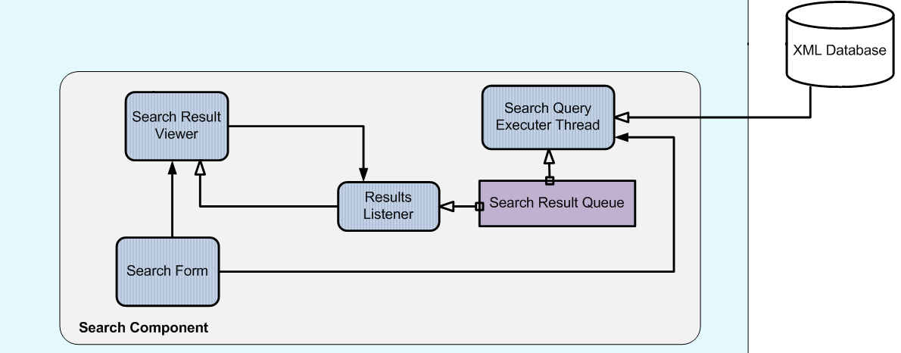
Dynamic View
Overview
Arch. & Design
Semester Overview
Proposals
Future
73

Slide 74
Unplanned Tasks
Test plan discussion
Risk meeting
Changing of code due to redesign
Fixing of style issues reported by Berkeley
Investigation into defect classification
Consolidation of the testing scenarios for the client
Discussion on changing of model names
Performance test plan
Fixing of JUnit tests
Computer problems
Resolving of SVN conflict
Mac OS problem reported by Christopher
Investigation into Actor Oriented Classes
Minor GUI issues

Slide 75
Process Improvements
Consistent tracking of defect fix time
Standardized defect categories (orthogonal classification)
Process for incorporating new tasks into plan
Tracking of Javadoc issues
Tracking of coverage statistics
Selection of Risk Manager
Use of interfaces to allow independent development
Action item reminders
Arranging of tasks weekly
Tracking of Findbugs and Junit failures

Slide 76
Orthogonal Defect Classification
Type | Definition
Documentation | Documentation says that the code does something that it does not.
Assignment | Declaration, duplicate names, assignment to wrong variable, variable scope.
Interface | Interfacing with the database or Ptolemy causes a problem.
Checking | Error messages are wrong, inadequate checking.
Data | Format of data is incorrect.
Function | Logic. Incorrect user interface. Affects significant capability.
System | Performance, usability, configuration (outside java code).
Regression | Defects that are the result of planned changes elsewhere in the code.

Slide 77
Number of Defects by Type

Slide 78
Number of Defects by Severity

Slide 79
Team Morale Tracking
 |  | Week Number
 |  | 1 | 2 | 3 | 4 | 5 | 6 | 7 | 8 | 9 | 10 | 11
Team Member | Alek | Good | Good | Good | Good | Good | Bad | Good | Good | Good | Good | Good
 | Ashwini | Good | Good | Bad | Bad | Good | Good | Good | Good | Good | Good | Good
 | Lyle | Good | Bad | Good | Good | Bad | Good | Good | Good | Good | Good | Good
 | Yousef | Good | Good | Good | Good | Good | Good | Good | Good | Good | Good | Good

Slide 80
Requirements: Release 1
Id | Requirement | Priority
REQ1 | Modelers must be able to store models to and retrieve models from a local database. | 0 - Basic
REQ2 | The project must include support for at least one open-source database platform. | 0 - Basic
REQ4 | Modelers must be able to retrieve a model stored in a database, view it, and edit it in the Ptolemy editing pane. | 0 - Basic
REQ6 | Modelers must be able to save a simple model in the Ptolemy editing pane to a database. | 0 - Basic
REQ11 | Modelers must be able to search the database based on attributes of a model. | 0 - Basic

Slide 81
Requirements: Release 2
Id | Requirement | Priority
REQ5 | Modelers must be able to include a model from the database as a sub-model by value | 0 - Basic
REQ7 | Modelers must be able to include a model from the database as a sub-model. | 0 - Basic
REQ8 | Changes to a sub-model will be propagated to all parent models. | 0 - Basic
REQ10 | Modelers must be able to define search criteria and search for models in the database. | 0 - Basic

Slide 82
Requirements: Release 2
Id | Requirement | Priority
REQ28 | The search capabilities must be extensible so that new ways of searching the data can be added later. | 0 - Basic
REQ14 | The modeler must be able to define categories of models. When saving a model to the database, the modeler must be able to assign a category to it. | 1 - First Level
REQ15 | Modelers must be able to store models to and retrieve models from a remote database. | 1 - First Level
REQ19 | Modelers must be able to search the database based on user-defined graph patterns. | 1 - First Level
REQ27 | Modelers must be able to search the database for models created by a specific person. | 2 - Second Level

Slide 83
Requirements: Release 3
Id | Requirement | Priority
REQ30 | The project must provide enough information such that an experienced database administrator can easily establish the database structure. A measure for this will be established as part of a Quality Attribute Workshop. | 0 - Basic
REQ9 | If changes are made to a sub-model within a parent model, the binding to the parent model will be broken. | 0 - Basic
REQ12 | The core functionality of Ptolemy shall not be affected by the addition of the database interface. | 0 - Basic
REQ13 | In the presence of errors, the application must continue to run without changing the Ptolemy Modeler’s saved work or the base Ptolemy functionality. | 0 - Basic

Slide 84
Requirements: Release 3
Id | Requirement | Priority
REQ16 | The database must be able to store at least 10,000 models. | 1 - First Level
REQ17 | The user should be able to upload large batches of Ptolemy XML files into the database. | 1 - First Level
REQ18 | If changes are made to a sub-model that is included by reference, modelers must be given the option to save the sub-model as a new model in the database, thereby changing the reference. | 1 - First Level
REQ29 | The Modeler must be able to save search criteria so that advanced searches need not be recreated. | 2 - Second Level

Slide 85
Requirements: Release 4 (Fall)
Id | Requirement | Priority
REQ20 | One or more demos must be added to the standard Ptolemy installation. | 1 - First Level
REQ22 | The model transformation feature of Ptolemy must be extended to allow replacement of user-defined patterns with the result of a query. (Design Only) | 2 - Second Level
REQ23 | Modelers must be able to apply the results of a model transformation to models in the database (user interaction required before execution). (Design Only) | 2 - Second Level
REQ24 | Modelers must be able to save a selected portion of a model as a sub-model in the database. | 2 - Second Level

Slide 86
Requirements: Release 4 (Fall)
Id | Requirement | Priority
REQ26 | Modelers must be able to search the database using a simple query building interface. | 2 - Second Level
REQ30 | The model transformation feature of Ptolemy should be extended to allow transformation of many models in the database that match a user-defined pattern. (Design Only) | 2 - Second Level
REQ31 | Extend searches to allow searching by attribute class. | 2 – Second Level
REQ32 | Extend search to allow “OR” searches in addition to “AND” searches. | 2 – Second Level
REQ33 | Extend search to allow model documentation search. | 2 – Second Level
REQ34 | Create a model index feature that allows listing of all models currently stored in the database. | 2 - Second Level

Slide 87
 |  |  | Planned | Actual |  | Planned | Actual
Development | 927.5 | Development | 1158.9 | 927.5 | On-Task | 1289.4 | 1114.6
 |  | Design | 348.3 | 236.7
 |  | Coding | 255.3 | 270.2
 |  | Unit Testing | 165.2 | 150.4
 |  | Design Review | 94.2 | 35.2
 |  | Code Review | 63.6 | 49.1
 |  | System Testing | 56.8 | 55.3
 |  | Peer Review | 55.5 | 31.9
 |  | Fagan Inspections | 35.0 | 30.5
 |  | Integration Testing | 28.5 | 24.9
 |  | Release Demo | 25.5 | 16.8
 |  | Release Notes | 16.7 | 11.8
 |  | User Documentation | 14.5 | 14.6
Studio Activities | 242.4 | EOSP | 130.5 | 187.1
 |  | Mentor Meetings |  | 44.6
 |  | Studio Management |  | 10.7
Client Interaction & Meetings | 191.95 | Client Meetings |  | 41.25
 |  | Action Items |  | 111.3
 |  | Communication |  | 39.4
Environment Setup |  |  | 52
Unplanned |  |  | 40.05
TSP | 274.35 | TSP Launch |  | 89.75
 |  | Status Meetings |  | 49
 |  | Iteration Planning |  | 55.45
 |  | Standup Meetings |  | 80.15
Total | 1728.2

Slide 88
FAGAN Inspections
 | Feature | Date | Effort (Hours) | Issues found
Release 1 | Load Ptolemy Model | 14th June 2010 | 5.6 | 8
Release 2 | Graphical Pattern Search | 6th July 2010 | 15.4 | 10

Slide 89
Some FAGAN Issues
What will happen if the dbModel returned is null. Do you want to handle it? [Elizabeth Latronico]
This class does not have a state. Could you make the method static? [Christopher Brooks]
Consider refactoring this API into two. One which parses a MOML String and returns an entity and other which converts that entity into a PtolemyEffigy. This can then be reused while importing a sub-model into the model. [Charles Shelton]
While creating an Effigy from the entity, look for using the filters set in Ptolemy. [Christopher Brooks]
The code that converts the String to PtolemyEffigy might be already be written in some place in Ptolemy. Could you reuse that? (Don’t know if this is an issue that the author can solve.) [Christopher Brooks]
You discard the XMLDBModel by converting it into a PtolemyEffigy. Is there any state preserved in XMLDBModel that will be lost due to this conversion? [Elizabeth Latronico]

Slide 90
Defects in phases
Phase Injected | Number of Defects | Count of Defects
Code | 171 | 72%
Design | 66 | 28%
Total | 237
Phase Removed | Number of Defects | Count of Defects
Design Review | 26 | 11%
Code Review | 74 | 31%
Unit Testing | 43 | 18%
Peer Code Review | 24 | 10%
Integration Testing | 43 | 18%
System Testing | 27 | 11%
Total | 237

Slide 91
Phase Yields
Phase | % Removed
Design | 0%
Design Review | 39%
Code | 0%
Code Review | 35%
Unit Testing | 31%
Peer Code Review | 26%
Integration Testing | 61%
System Testing | 100%
23 Defects per KLOC

